Slide 1
Exception Handling
Limitations of Test cases:
  If test cases fail in way that it affects the next test cases, it becomes difficult to run the next cases
Purpose:
  Exception handling
Notes:
Test cases have certain limitations. If a test case fails for any reason then it becomes difficult for the next test case to run
Hence exception handling is used to come out of the test case which is not ale to run so that the next test case can be run

Slide 2
Exception Handling
Initialization & Cleanup for
Test Case/Molecule
Initialization & Cleanup for Test Suite
Notes:
Exception handling can be done by Initialization and Cleanup steps.
Initialization & cleanup are available for Test case , molecule and Test suite.
When the initialization step fails the cleanup step is executed and comes out of the test case.
Also it is possible to set a time limit for each step so that it does not wait for it indefinitely to finish.

Slide 3
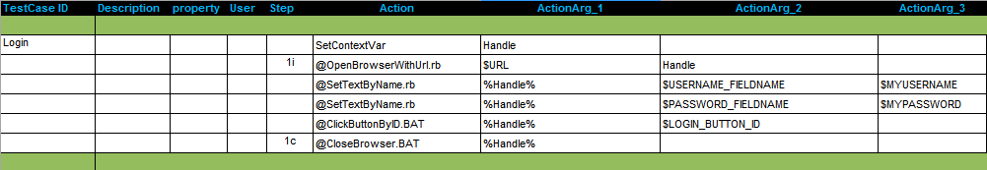
Exception Handling : Test Case
Initialization & Cleanup steps
Notes:
In a test case the action column consists of several steps which are executed sequentially. If a step fails then the whole test case fails and it comes out the test case reporting it as failed.
In the example step 2 is the initialization step and step 6 is the clean up for it. So, if step 2 fails then automatically the cleanup will be executed for the test case.

Slide 4
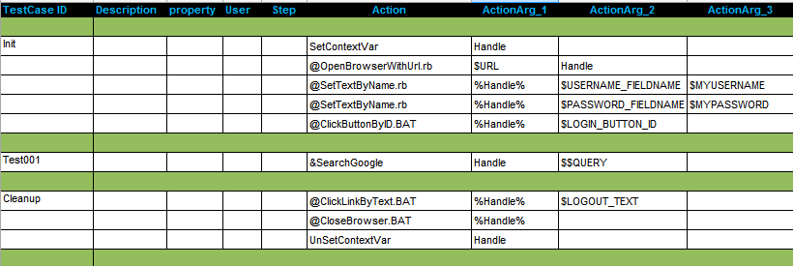
Initialization & Cleanup Test Case
Initialization & Cleanup Test Case
Notes:
A test suite can have a initialization and cleanup test cases, initialization case is executed automatically and then the other test cases in the suite.
The cleanup test case is executed even if all the cases fail so that the clean up for the test suite is done.
Both initialization and clean up are not reported to the database.

Slide 5
Exercise : Exception Handling
Write a test case that uses initialization and cleanup steps for searching in google.
Notes:
Example Sheet - Test009

Slide 6
External Sheets
Limitation of using Test Suite:
  Cannot use molecules that are defined in some other test suite
  Copy and paste is difficult to maintain
Purpose:
  Reuse the existing molecules/Macros and maintain a single copy.
  Common testing logic can be shared between test suites.

Slide 7
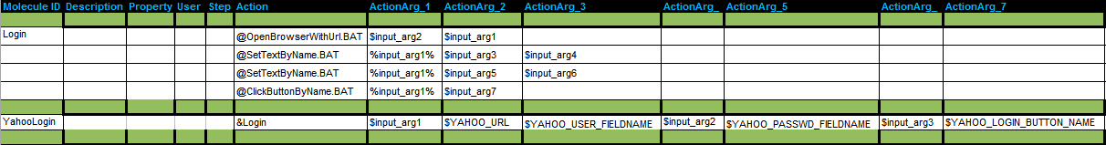
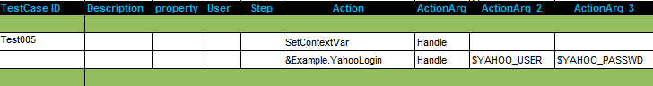
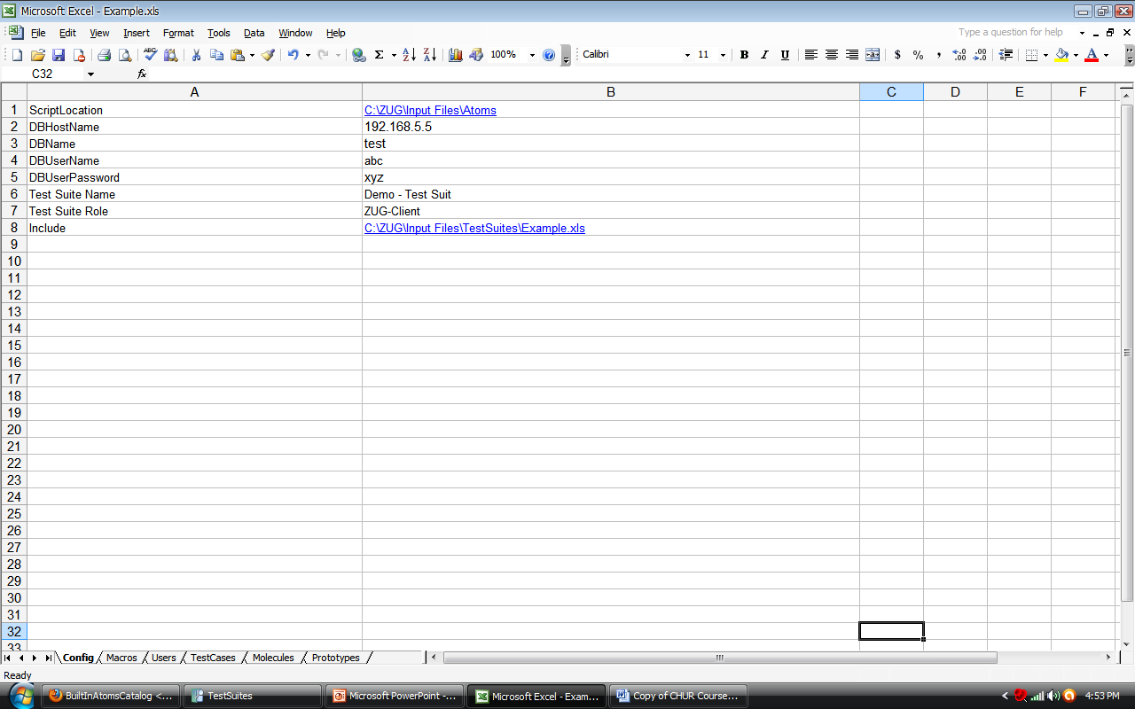
Example : External Molecules
These molecules are in a file named Example.xls
Filename - Namespace
File path of Example.xls needs to be mentioned in the config sheet
Notes:
ZUG also allows the test suite designer to reference molecules and macros defined in files, other than the current input file. This promotes reusability of existing design molecules.
Since each external file is assumed to contain unique names, but name uniqueness cannot be guaranteed between all referenced files, the concept of namespaces are used. The filename is used as the namespace to call the molecules and Macros in it.

Slide 8
Exercise : External Molecules
Login to Gmail and YahooMail using external molecules.

